Slide 1

SMART MOBILITY

Slide 2

Project Scope refers to the combined objectives and requirements needed to complete a project. It is a way to set boundaries on your project and define exactly what goals, deadlines, and project deliverables you'll be working towards.
The fundamental idea of the project is to ease student commuting in our city using bicycles/ bikes.
For this, we’re using the Cyber Physical Systems (CPS) methodology, relating it to the real world by using a fewer technologies and some devices.

Slide 3


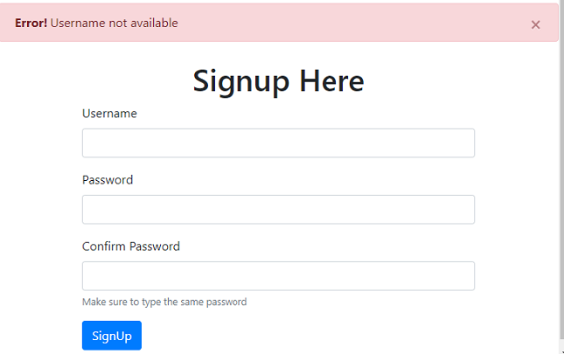
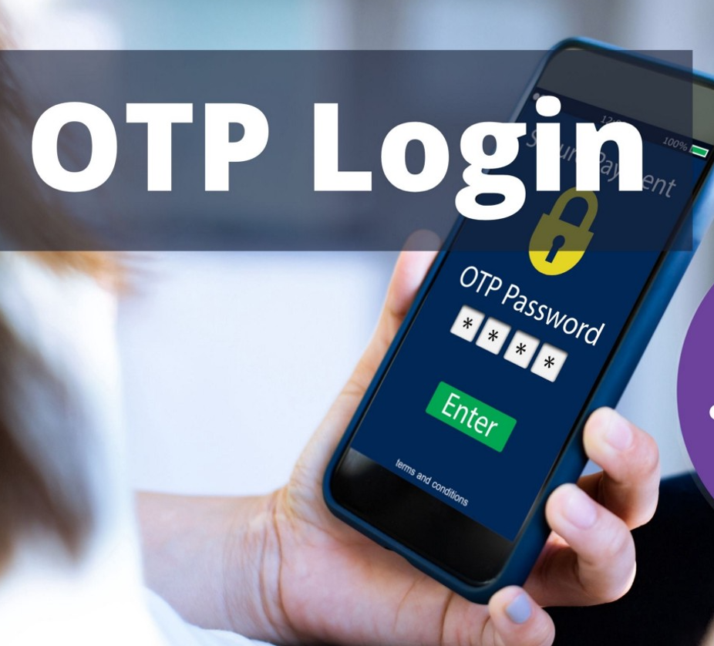
First time users need to install the application.
Signup/ Registration, for the account creation. Once they create it, they can add the Credit or Debit cards to the account or can add money to the Wallet.
Once the user completes signing up, they can login into the app by receiving and entering the OTP (one Time Password). This is the first step of the two-step verification.

Slide 4
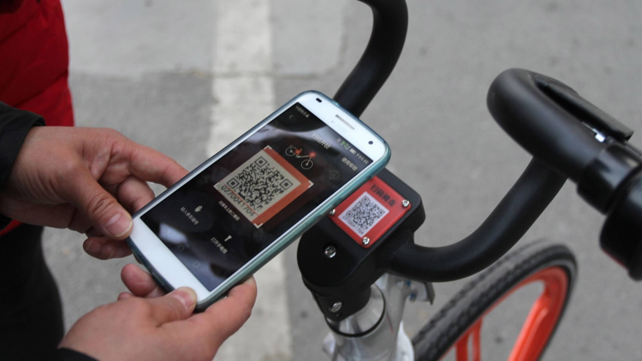


As every bicycle/ bike has a unique QR Code (which has the data of a unique vehicle ID), when the user turns on the Bluetooth and taps on book a ride, the camera in the application turns on and they need to scan the QR Code of the particular bicycle. This becomes the second step of verification for the two-step verification process.
The user needs to select if he wants a point-to-point ride or a minutely ride, depending on his necessity. From then, the bicycles get un-locked and the users can start their ride. Alongside the ride, the timer in the mobile app turns on.
Mistakenly, if the user forgets to turn the Bluetooth off or locking the bicycle, there will be an alert sent to their mobile stating the emergency. Leaving the bicycle unlocked leads to the theft of it or over charges. Hence, it’s always suggested to lock the bicycle once you are done using it.

Slide 5
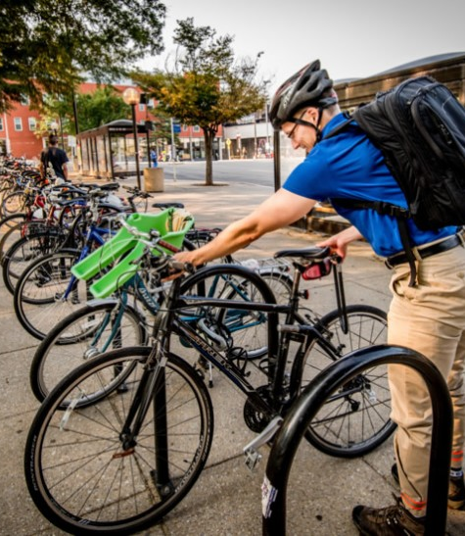
Once the biker reaches their destination, they must lock the bicycle, disconnect the Bluetooth and end the ride. So that it’s hasel-free.

Slide 6
6 Key Steps to a Project Scope Statement
1. Understand why the project was initiated - We’re trying to provide easy transportation to students, as there isn’t basic public transportation available in the city.
2. Define the key objectives of the project – By end of November, we will implement this mode of transportation in the city. Before implementing, we have trial sessions as well.
3. Outline the project statement of work – We segregate and break down the work into several components. Such as Developing the code, Testing and Debugging the app, implementing it, right materialistic purchases, etcetera.
4. Identify major deliverables - Project team will be working alongside key stakeholders to list the items that will be delivered at the end of the project. If we’re able to deliver easy and safe rides at the customers/ students convenience, it says we reached most of our deliverables.

Slide 7
5. Select key milestones – Working on how to design the Bluetooth connections, QR Scanners and linking the unique data into it.
6. Identify major constraints/ Limitations – Limiting our project to certain aspects like Inventory Damage And Repair, any lack of safety gear can increase the likelihood of injury to bikers and possibly pedestrians.
Going further with the 17 procurements which we collected, we’re hoping for the better implementations in the project.

Slide 8


